Slide 1
UNIT-II Chapter-2 Map-Reduce

Slide 2
Topics
Chapter-I (Map Reduce)
1. A Weather Dataset
Data Format
2. Analyzing the data with UNIX Tools
3. Analyzing the data with Hadoop
Map and reduce
Java Map reduce
4. Scaling Out
5. Hadoop Streaming
6. Hadoop Pipes

Slide 3
MapReduce:
MapReduce is a programming model for data processing.
Hadoop can run Mapreduce programs written in various languages like Java, Ruby, Python and C++.
MapReduce programs are inherently parallel, thus putting very large-scale data analysis into the hands of anyone with enough machines at their disposal.
I)A Weather Dataset
Weather sensors collecting data every hour at many locations across the globe gather a large volume of log data, which is good for analysis with MapReduce, since it is semi-structured and record-oriented.
Data Format
Using the data of NCDC( National Climatic Data Center, http://www.ncdc.noaa.gov/).
The data is stored using a line-oriented ASCII format, in which each line is a record. The format supports a rich set of meteorological (related to humidity, temperature, wind and precipitation etc.) elements, many of which are optional or with variable data lengths. But the focus is on the basic elements such as temperature, which are always present and are of fixed width.

Slide 4
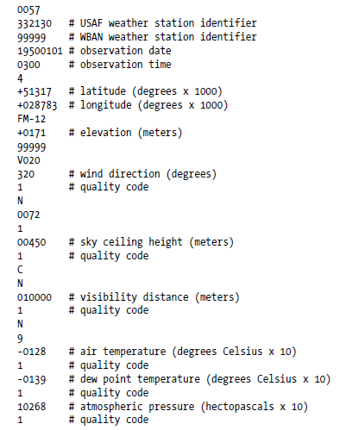
Example 2-1:
Shows a sample line with some of the salient fields highlighted. The line has been split into multiple lines to show each field: in the real file, fields are packed into one line with no delimiters.

Slide 5
Data files are organized by date and weather station. There is a directory for each year from 1901 to 2001, each containing a gzipped file for each weather station with its readings for that year. For example, here are the first entries for 1990:
% ls raw/1990 | head
010010-99999-1990.gz
010014-99999-1990.gz
010015-99999-1990.gz
010016-99999-1990.gz
010017-99999-1990.gz
010030-99999-1990.gz
010040-99999-1990.gz
010080-99999-1990.gz
010100-99999-1990.gz
010150-99999-1990.gz
Since there are tens of thousands of weather stations, the whole dataset is made up of a large number of relatively small files. It’s generally easier and more efficient to process a smaller number of relatively large files, so the data was pre-processed so that each year’s readings were concatenated into a single file.

Slide 6
II) Analyzing the Data with Unix Tools
Q) What’s the highest recorded global temperature for each year in the dataset?
Without using Hadoop, as the information will provide a performance baseline, as well as a useful means to check the results.
Approach used for processing line-oriented data is awk.
Script to calculate the maximum temperature for each year.
Example 2-2. A program for finding the maximum recorded temperature by year from NCDC weather records
#!/usr/bin/env bash
for year in all/*
do
echo -ne `basename $year .gz`"\t"
gunzip -c $year | \
awk '{ temp = substr($0, 88, 5) + 0;
q = substr($0, 93, 1);
if (temp !=9999 && q ~ /[01459]/ && temp > max) max = temp }
END { print max }'
Done.

Slide 7
The script loops through the compressed year files, first printing the year, and then processing each file using awk.
The awk script extracts two fields from the data. They are:
1. the air temperature
2. quality code
The air temperature value is turned into an integer by adding 0. Then a check is done whether the temperature is valid or not. If valid the value is compared with maximum value seen so far, which is updated if a new maximum is found. The END block is executed after all the lines in the file have been processed, and it prints the maximum value.
Output:
Here is the beginning of a run:
% ./max_temperature.sh
1901 317
1902 244
1903 289
1904 256
1905 283
...
The temperature values in the source file are scaled by a factor of 10,so the maximum temperature of 31.7 degree C for 1900.

Slide 8
The complete run for the century took 42minutes .
To speed up the processing, we need to run parts of the program in parallel. In theory, this is straightforward, we could process different years in different processes, using all the available hardware threads on a machine. There are few problems with this mechanism.
First, dividing the work into equal-size pieces isn’t always easy or obvious. In the case, the file size for different years varies widely, so some processes will finish much earlier than others. Even if they pick up further work, the whole run is dominated by the longest file. A better approach, although one that requires more work, is to split the input fixed-size chunks and assign each chunk to a process.
Second, combining the results from independent process may need further processing. In this case, the result for each year is independent of other years and may be combined by concatenating all the results, and sorting by year. If using the fixed-size chunk approach, the combination is more delicate.
Eg: Data for a particular year will typically be split into several chuncks, each processed independently. We’ll end up with the maximum temperature for each chunk, so the final step is to look for the highest of these maximums, for each year.
Third, you are still limited by the processing capacity of a single machine. If the best time you can achieve is 20minutes with the number of processors you have, then that’s it.. You can’t make it go faster. Also, some datasets grow beyond the capacity of a single machine. When we start using multiple machines, a whole host of other factors come into play,

Slide 9
mainly falling in the category of coordination and reliability. Who runs the overall job? How do we deal with failed processes?
So, though it’s feasible to parallelize the processing, in practice it’s messy. Using a framework like Hadoop to take care of these issues is a great help.
III) Analyzing the Data with Hadoop
To take advantage of the parallel processing that Hadoop provides, we need to express our query as a MapReduce job. After some local, small-scale testing, we will be able to run it on a cluster of machines.
Map and Reduce
Map Reduce works by breaking the processing into two phases:
1. the map phase
2. the reduce phase
Each phase has key-value pairs as input and output, the types of which may be choosen by the programmer. The programmer also specifies two functions: the map function and the reduce function.
The input to our map phase is the raw NCDC data. We choose a text input format that gives us each line in the dataset as a text value. The key is the offset of the beginning of the line from the beginning of the file, but as we have no need for this, we ignore it.

Slide 10
Our map function is simple. We pull out the year and the air temperature, since these are the only fields we are interested in. In this case, the map function is just a data preparation phase, setting up the data in such a way that the reducer function can do its work on it: finding the maximum temperature for each year. The map function is also a good place to drop bad records: here we filter out temperatures that are missing, suspect, or erroneous.
To visualize the way the map works, consider the following sample lines of input data
(some unused columns have been dropped to fit the page, indicated by ellipses):
0067011990999991950051507004...9999999N9+00001+99999999999...
0043011990999991950051512004...9999999N9+00221+99999999999...
0043011990999991950051518004...9999999N9-00111+99999999999...
0043012650999991949032412004...0500001N9+01111+99999999999...
0043012650999991949032418004...0500001N9+00781+99999999999...
These lines are presented to the map function as the key-value pairs:
(0, 0067011990999991950051507004...9999999N9+00001+99999999999...)
(106, 0043011990999991950051512004...9999999N9+00221+99999999999...)
(212, 0043011990999991950051518004...9999999N9-00111+99999999999...)
(318, 0043012650999991949032412004...0500001N9+01111+99999999999...)
(424, 0043012650999991949032418004...0500001N9+00781+99999999999...)

Slide 11
The keys are the line offsets within the file, which we ignore in our map function. The
map function merely extracts the year and the air temperature (indicated in bold text),
and emits them as its output (the temperature values have been interpreted as
integers):
(1950, 0)
(1950, 22)
(1950, −11)
(1949, 111)
(1949, 78)
The output from the map function is processed by the MapReduce framework before
being sent to the reduce function. This processing sorts and groups the key-value pairs
by key. So, continuing the example, our reduce function sees the following input:
(1949, [111, 78])
(1950, [0, 22, −11])
Each year appears with a list of all its air temperature readings. All the reduce function
has to do now is iterate through the list and pick up the maximum reading:
(1949, 111)
(1950, 22)
This is the final output: the maximum global temperature recorded in each year.

Slide 12
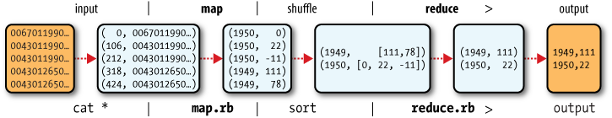
The whole data flow is shown in the diagram below. At the bottom of the diagram is a Unix pipeline, which mimics the whole MapReduce flow, and which we will see again later
in the chapter when we look at Hadoop Streaming.
MapReduce logical Data Flow
Java MapReduce
Having run through how the MapReduce program works, the next step is to express it
in code. We need three things: a map function, a reduce function, and some code to
run the job. The map function is represented by the Mapper class, which declares an
abstract map() method.

Slide 13
Mapper for max temperature example: shows the implementation of our map method:
import java.io.IOException;
import org.apache.hadoop.io.IntWritable;
import org.apache.hadoop.io.LongWritable;
import org.apache.hadoop.io.Text;
import org.apache.hadoop.mapreduce.Mapper;
public class MaxTemperatureMapper
extends Mapper<LongWritable, Text, Text, IntWritable> {
private static final int MISSING = 9999;
@Override
public void map(LongWritable key, Text value, Context context)
throws IOException, InterruptedException {
String line = value.toString();
String year = line.substring(15, 19);
int airTemperature;
if (line.charAt(87) == '+') { // parseInt doesn't like leading plus signs
airTemperature = Integer.parseInt(line.substring(88, 92));
} else {
airTemperature = Integer.parseInt(line.substring(87, 92));
}
String quality = line.substring(92, 93);
if (airTemperature != MISSING && quality.matches("[01459]")) {
context.write(new Text(year), new IntWritable(airTemperature));
}}}

Slide 14
The Mapper class is a generic type, with four formal type parameters that specify the
input key, input value, output key, and output value types of the map function. For the
present example, the input key is a long integer offset, the input value is a line of text, the output key is a year, and the output value is an air temperature (an integer).
Rather than use built-in Java types, Hadoop provides its own set of basic types that are optimized for network serialization. These are found in the org.apache.hadoop.io package.
Here we use LongWritable, which corresponds to a Java Long, Text (like Java String),
and IntWritable (like Java Integer).
The map() method is passed a key and a value. We convert the Text value containing
the line of input into a Java String, then use its substring() method to extract the
columns we are interested in.
The map() method also provides an instance of Context to write the output to. In this
case, we write the year as a Text object (since we are just using it as a key), and the
temperature is wrapped in an IntWritable. We write an output record only if the temperature is present and the quality code indicates the temperature reading is OK.

Slide 15
The reduce function is similarly defined using a Reducer
Reducer for maximum temperature example:
import java.io.IOException;
import org.apache.hadoop.io.IntWritable;
import org.apache.hadoop.io.Text;
import org.apache.hadoop.mapreduce.Reducer;
public class MaxTemperatureReducer
extends Reducer<Text, IntWritable, Text, IntWritable> {
@Override
public void reduce(Text key, Iterable<IntWritable> values, Context context)
throws IOException, InterruptedException {
int maxValue = Integer.MIN_VALUE;
for (IntWritable value : values) {
maxValue = Math.max(maxValue, value.get());
}
context.write(key, new IntWritable(maxValue));
}}
Again, four formal type parameters are used to specify the input and output types, this time for the reduce function. The input types of the reduce function must match the output types of the map function: Text and IntWritable. And in this case, the output types of the reduce function are Text and IntWritable, for a year and its maximum temperature, which we find by iterating through the temperatures and comparing each with a record of the highest found so far.

Slide 16
The third piece of code runs the MapReduce job:
Application to find the maximum temperature in the weather dataset
import org.apache.hadoop.fs.Path;
import org.apache.hadoop.io.IntWritable;
import org.apache.hadoop.io.Text;
import org.apache.hadoop.mapreduce.Job;
import org.apache.hadoop.mapreduce.lib.input.FileInputFormat;
import org.apache.hadoop.mapreduce.lib.output.FileOutputFormat;
public class MaxTemperature {
public static void main(String[] args) throws Exception {
if (args.length != 2) {
System.err.println("Usage: MaxTemperature <input path> <output path>");
System.exit(-1);}
Job job = new Job();
job.setJarByClass(MaxTemperature.class);
job.setJobName("Max temperature");
FileInputFormat.addInputPath(job, new Path(args[0]));
FileOutputFormat.setOutputPath(job, new Path(args[1]));
job.setMapperClass(MaxTemperatureMapper.class);
job.setReducerClass(MaxTemperatureReducer.class);
job.setOutputKeyClass(Text.class);
job.setOutputValueClass(IntWritable.class);
System.exit(job.waitForCompletion(true) ? 0 : 1);}}

Slide 17
A test run
After writing a MapReduce job, it’s normal to try it out on a small dataset to flush out
any immediate problems with the code.
% export HADOOP_CLASSPATH=hadoop-examples.jar
% hadoop MaxTemperature input/ncdc/sample.txt output
Output:
The output was written to the output directory, which contains one output file per
reducer. The job had a single reducer, so we find a single file, named part-r-00000:
% cat output/part-r-00000
1949 111
1950 22
This result is the same as when we went through it by hand earlier. We interpret this
as saying that the maximum temperature recorded in 1949 was 11.1°C, and in 1950 it
was 2.2°C.

Slide 18
The old and the new Java MapReduce APIs:
There are several notable differences between the two APIs:
• The new API favors abstract classes over interfaces, since these are easier to evolve.
For example, you can add a method (with a default implementation) to an abstract
class without breaking old implementations of the class2. For example, the
Mapper and Reducer interfaces in the old API are abstract classes in the new API.
• The new API is in the org.apache.hadoop.mapreduce package (and subpackages).
The old API can still be found in org.apache.hadoop.mapred.
• The new API makes extensive use of context objects that allow the user code to communicate with the MapReduce system. The new Context, for example, essentially unifies the role of the JobConf, the OutputCollector, and the Reporter from the old API.
• In both APIs, key-value record pairs are pushed to the mapper and reducer, but in addition, the new API allows both mappers and reducers to control the execution flow by overriding the run() method. For example, records can be processed in batches, or the execution can be terminated before all the records have been processed. In the old API this is possible for mappers by writing a MapRunnable, but no equivalent exists for reducers.
• Configuration has been unified. The old API has a special JobConf object for job configuration, which is an extension of Hadoop’s vanilla Configuration object (used for configuring daemons; see “The Configuration API” on page 146). In the new API, this distinction is dropped, so job configuration is done through a Configuration.
• Job control is performed through the Job class in the new API, rather than the old JobClient, which no longer exists in the new API.

Slide 19
Output files are named slightly differently: in the old API both map and reduce outputs are named part-nnnnn, while in the new API map outputs are named partm- nnnnn, and reduce outputs are named part-r-nnnnn (where nnnnn is an integer designating the part number, starting from zero).
• User-overridable methods in the new API are declared to throw java.lang.Inter
ruptedException. What this means is that you can write your code to be reponsive to interupts so that the framework can gracefully cancel long-running operations if it needs to3.
• In the new API the reduce() method passes values as a java.lang.Iterable, rather than a java.lang.Iterator (as the old API does). This change makes it easier to iterate over the values using Java’s for-each loop construct:
for (VALUEIN value : values) { ... }
MaxTemperature application rewritten to use the old API. The differences are highlighted in bold.
public class OldMaxTemperature {
static class OldMaxTemperatureMapper extends MapReduceBase
implements Mapper<LongWritable, Text, Text, IntWritable> {
private static final int MISSING = 9999;
public void map(LongWritable key, Text value,
OutputCollector<Text, IntWritable> output, Reporter reporter)
throws IOException {
String line = value.toString();

Slide 20
String year = line.substring(15, 19);
int airTemperature;
if (line.charAt(87) == '+') { // parseInt doesn't like leading plus signs
airTemperature = Integer.parseInt(line.substring(88, 92));
} else {
airTemperature = Integer.parseInt(line.substring(87, 92));
}
String quality = line.substring(92, 93);
if (airTemperature != MISSING && quality.matches("[01459]")) {
output.collect(new Text(year), new IntWritable(airTemperature));
}
}
}
static class OldMaxTemperatureReducer extends MapReduceBase
implements Reducer<Text, IntWritable, Text, IntWritable> {
public void reduce(Text key, Iterator<IntWritable> values,
OutputCollector<Text, IntWritable> output, Reporter reporter)
throws IOException {
int maxValue = Integer.MIN_VALUE;
while (values.hasNext()) {
maxValue = Math.max(maxValue, values.next().get());
}

Slide 21
output.collect(key, new IntWritable(maxValue));
}
}
public static void main(String[] args) throws IOException {
if (args.length != 2) {
System.err.println("Usage: OldMaxTemperature <input path> <output path>");
System.exit(-1);
}
JobConf conf = new JobConf(MaxTemperatureWithCombiner.class);
conf.setJobName("Max temperature");
FileInputFormat.addInputPath(conf, new Path(args[0]));
FileOutputFormat.setOutputPath(conf, new Path(args[1]));
conf.setMapperClass(OldMaxTemperatureMapper.class);
conf.setReducerClass(OldMaxTemperatureReducer.class);
conf.setOutputKeyClass(Text.class);
conf.setOutputValueClass(IntWritable.class);
JobClient.runJob(conf);
}
}

Slide 22
IV)Scaling Out
You’ve seen how MapReduce works for small inputs; now it’s time to take a bird’s-eye view of the system and look at the data flow for large inputs. For simplicity, the examples so far have used files on the local filesystem. However, to scale out, we need to store the data in a distributed filesystem, typically HDFS (which you’ll learn about in the next chapter), to allow Hadoop to move the MapReduce computation to each machine hosting a part of the data. Let’s see how this works.
Data Flow
First, some terminology. A MapReduce job is a unit of work that the client wants to be performed: it consists of the input data, the MapReduce program, and configuration information. Hadoop runs the job by dividing it into tasks, of which there are two types: map tasks and reduce tasks.
There are two types of nodes that control the job execution process: a jobtracker and a number of tasktrackers. The jobtracker coordinates all the jobs run on the system by scheduling tasks to run on tasktrackers. Tasktrackers run tasks and send progress reports to the jobtracker, which keeps a record of the overall progress of each job. If a task fails, the jobtracker can reschedule it on a different tasktracker.
Hadoop divides the input to a MapReduce job into fixed-size pieces called input splits, or just splits. Hadoop creates one map task for each split, which runs the userdefined map function for each record in the split.
Having many splits means the time taken to process each split is small compared to the
time to process the whole input. So if we are processing the splits in parallel, the processing
is better load-balanced if the splits are small, since a faster machine will be able to process

Slide 23
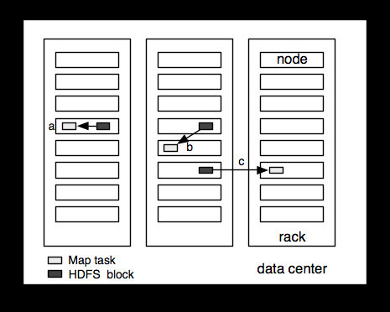
proportionally more splits over the course of the job than a slower machine.
Even if the machines are identical, failed processes or other jobs running concurrently make load balancing desirable, and the quality of the load balancing increases as the splits become more fine-grained.
On the other hand, if splits are too small, then the overhead of managing the splits and
of map task creation begins to dominate the total job execution time. For most jobs, a good split size tends to be the size of an HDFS block, 64 MB by default, although this can be changed for the cluster (for all newly created files), or specified when each file is created.
Hadoop does its best to run the map task on a node where the input data resides in HDFS. This is called the data locality optimization since it doesn’t use valuable cluster bandwidth. Sometimes, however, all three nodes hosting the HDFS block replicas for a map task’s input split are running other map tasks so the job scheduler will look for a free map slot on a node in the same rack as one of the blocks. Very occasionally even this is not possible, so an off-rack node is used, which results in an inter-rack network transfer. The three possibilities are illustrated in diagram below:
Data-local (a),
rack-local (b), and off-rack (c) map tasks.

Slide 24
It should now be clear why the optimal split size is the same as the block size: it is the largest size of input that can be guaranteed to be stored on a single node. If the split spanned two blocks, it would be unlikely that any HDFS node stored both blocks, so some of the split would have to be transferred across the network to the node running the map task, which is clearly less efficient than running the whole map task using local data.
Map tasks write their output to the local disk, not to HDFS. Why is this? Map output is intermediate output: it’s processed by reduce tasks to produce the final output, and once the job is complete the map output can be thrown away. So storing it in HDFS, with replication, would be overkill. If the node running the map task fails before the map output has been consumed by the reduce task, then Hadoop will automatically rerun the map task on another node to re-create the map output.
Reduce tasks don’t have the advantage of data locality—the input to a single reduce task is normally the output from all mappers. In the present example, we have a single reduce task that is fed by all of the map tasks. Therefore, the sorted map outputs have to be transferred across the network to the node where the reduce task is running, where they are merged and then passed to the user-defined reduce function.
The output of the reduce is normally stored in HDFS for reliability. For each HDFS block of the reduce output, the first replica is stored on the local node, with other replicas being stored on off-rack nodes. Thus, writing the reduce output does consume network bandwidth, but only as much as a normal HDFS write pipeline consumes.

Slide 25
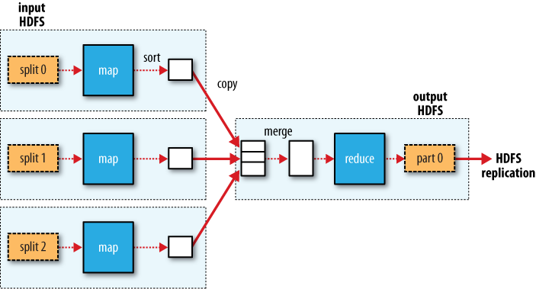
The whole data flow with a single reduce task is represented in the diagram below:
The dotted boxes indicate nodes, the light arrows show data transfers on a node, and the heavy arrows show data transfers between nodes.
MapReduce data flow with a single reduce task

Slide 26
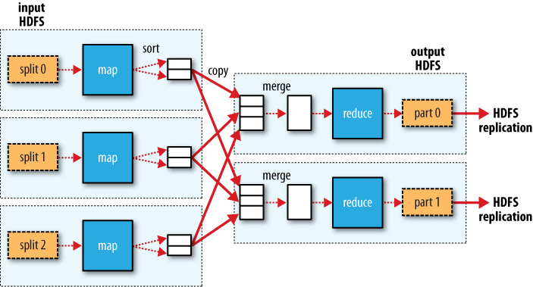
MapReduce data flow with multiple reduce tasks

Slide 27
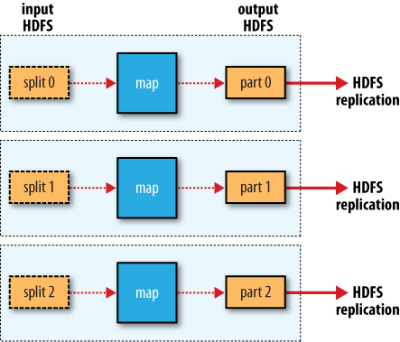
Combiner Functions
Many MapReduce jobs are limited by the bandwidth available on the cluster, so it pays to minimize the data transferred between map and reduce tasks. Hadoop allows the user to specify a combiner function to be run on the map output—the combiner function’s output forms the input to the reduce function. Since the combiner function is an optimization, Hadoop does not provide a guarantee of how many times it will call it for a particular map output record, if at all. In other words, calling the combiner function zero, one, or many times should produce the same output from the reducer.
MapReduce data flow with no reduce tasks

Slide 28
The contract for the combiner function constrains the type of function that may be
used. This is best illustrated with an example. Suppose that for the maximum temperature
example, readings for the year 1950 were processed by two maps (because they
were in different splits). Imagine the first map produced the output:
(1950, 0)
(1950, 20)
(1950, 10)
And the second produced:
(1950, 25)
(1950, 15)
The reduce function would be called with a list of all the values:
(1950, [0, 20, 10, 25, 15])
with output:
(1950, 25)
since 25 is the maximum value in the list. We could use a combiner function that, just
like the reduce function, finds the maximum temperature for each map output. The
reduce would then be called with:
(1950, [20, 25])
and the reduce would produce the same output as before. More succinctly, we may
express the function calls on the temperature values in this case as follows:
max(0, 20, 10, 25, 15) = max(max(0, 20, 10), max(25, 15)) = max(20, 25) = 25

Slide 29
Not all functions possess this property.4 For example, if we were calculating mean
temperatures, then we couldn’t use the mean as our combiner function, since:
mean(0, 20, 10, 25, 15) = 14
but:
mean(mean(0, 20, 10), mean(25, 15)) = mean(10, 20) = 15
The combiner function doesn’t replace the reduce function. (How could it? The reduce
function is still needed to process records with the same key from different maps.) But
it can help cut down the amount of data shuffled between the maps and the reduces,
and for this reason alone it is always worth considering whether you can use a combiner
function in your MapReduce job.
Specifying a combiner function:
Going back to the Java MapReduce program, the combiner function is defined using
the Reducer class, and for this application, it is the same implementation as the reducer
function in MaxTemperatureReducer.
Application to find the maximum temperature, using a combiner function for efficiency
public class MaxTemperatureWithCombiner {
public static void main(String[] args) throws Exception {
if (args.length != 2) {
System.err.println("Usage: MaxTemperatureWithCombiner <input path> " +
"<output path>");
System.exit(-1);
}

Slide 30
Job job = new Job();
job.setJarByClass(MaxTemperatureWithCombiner.class);
job.setJobName("Max temperature");
FileInputFormat.addInputPath(job, new Path(args[0]));
FileOutputFormat.setOutputPath(job, new Path(args[1]));
job.setMapperClass(MaxTemperatureMapper.class);
job.setCombinerClass(MaxTemperatureReducer.class);
job.setReducerClass(MaxTemperatureReducer.class);
job.setOutputKeyClass(Text.class);
job.setOutputValueClass(IntWritable.class);
System.exit(job.waitForCompletion(true) ? 0 : 1);
}
}
Running a Distributed MapReduce Job
The same program will run, without alteration, on a full dataset. This is the point of MapReduce: it scales to the size of your data and the size of your hardware. Here’s one
data point: on a 10-node EC2 cluster running High-CPU Extra Large Instances, the program took six minutes to run

Slide 31
V) Hadoop Streaming
Hadoop provides an API to MapReduce that allows you to write your map and reduce functions in languages other than Java. Hadoop Streaming uses Unix standard streams as the interface between Hadoop and your program, so you can use any language that can read standard input and write to standard output to write your MapReduce program.
Streaming is naturally suited for text processing (although, as of version 0.21.0, it can handle binary streams, too), and when used in text mode, it has a line-oriented view of data.
Map input data is passed over standard input to your map function, which processes it line by line and writes lines to standard output. A map output key-value pair is written as a single tab-delimited line. Input to the reduce function is in the same format—a tab-separated key-value pair—passed over standard input.
The reduce function reads lines from standard input, which the framework guarantees are sorted by key, and writes its results to standard output.

Slide 32
Let’s illustrate this by rewriting our MapReduce program for finding maximum temperatures by year in Streaming.
Ruby
The map function can be expressed in Ruby
Map function for maximum temperature in Ruby
#!/usr/bin/env ruby
STDIN.each_line do |line|
val = line
year, temp, q = val[15,4], val[87,5], val[92,1]
puts "#{year}\t#{temp}" if (temp != "+9999" && q =~ /[01459]/)
end
The program iterates over lines from standard input by executing a block for each line
from STDIN (a global constant of type IO). The block pulls out the relevant fields from
each input line, and, if the temperature is valid, writes the year and the temperature
separated by a tab character \t to standard output (using puts).
Since the script just operates on standard input and output, it’s trivial to test the script
without using Hadoop, simply using Unix pipes:
% cat input/ncdc/sample.txt | ch02/src/main/ruby/max_temperature_map.rb
1950 +0000
1950 +0022
1950 -0011
1949 +0111
1949 +0078

Slide 33
Reduce function for maximum temperature in Ruby
#!/usr/bin/env ruby
last_key, max_val = nil, 0
STDIN.each_line do |line|
key, val = line.split("\t")
if last_key && last_key != key
puts "#{last_key}\t#{max_val}"
last_key, max_val = key, val.to_i
else
last_key, max_val = key, [max_val, val.to_i].max
end
end
puts "#{last_key}\t#{max_val}" if last_key
We can now simulate the whole MapReduce pipeline with a Unix pipeline
% cat input/ncdc/sample.txt | ch02/src/main/ruby/max_temperature_map.rb | \
sort | ch02/src/main/ruby/max_temperature_reduce.rb
1949 111
1950 22
The output is the same as the Java program, so the next step is to run it using Hadoop
itself.
The hadoop command doesn’t support a Streaming option; instead, you specify the
Streaming JAR file along with the jar option.

Slide 34
Options to the Streaming program specify
the input and output paths, and the map and reduce scripts. This is what it looks like:
% hadoop jar $HADOOP_INSTALL/contrib/streaming/hadoop-*-streaming.jar \
-input input/ncdc/sample.txt \
-output output \
-mapper ch02/src/main/ruby/max_temperature_map.rb \
-reducer ch02/src/main/ruby/max_temperature_reduce.rb
When running on a large dataset on a cluster, we should set the combiner, using the
-combiner option.
From release 0.21.0, the combiner can be any Streaming command. For earlier releases,
the combiner had to be written in Java, so as a workaround it was common to do manual
combining in the mapper, without having to resort to Java. In this case, we could change
the mapper to be a pipeline:
% hadoop jar $HADOOP_INSTALL/contrib/streaming/hadoop-*-streaming.jar \
-input input/ncdc/all \
-output output \
-mapper "ch02/src/main/ruby/max_temperature_map.rb | sort |
ch02/src/main/ruby/max_temperature_reduce.rb" \
-reducer ch02/src/main/ruby/max_temperature_reduce.rb \
-file ch02/src/main/ruby/max_temperature_map.rb \
-file ch02/src/main/ruby/max_temperature_reduce.rb

Slide 35
Python
Streaming supports any programming language that can read from standard input, and
write to standard output.
Find maximum temperature for each year using Python.
Map function for maximum temperature in Python
#!/usr/bin/env python
import re
import sys
for line in sys.stdin:
val = line.strip()
(year, temp, q) = (val[15:19], val[87:92], val[92:93])
if (temp != "+9999" and re.match("[01459]", q)):
print "%s\t%s" % (year, temp)

Slide 36
Reduce function for maximum temperature in Python
#!/usr/bin/env python
import sys
(last_key, max_val) = (None, 0)
for line in sys.stdin:
(key, val) = line.strip().split("\t")
if last_key and last_key != key:
print "%s\t%s" % (last_key, max_val)
(last_key, max_val) = (key, int(val))
else:
(last_key, max_val) = (key, max(max_val, int(val)))
if last_key:
print "%s\t%s" % (last_key, max_val)
We can test the programs and run the job in the same way we did in Ruby. For example,
to run a test:
% cat input/ncdc/sample.txt | ch02/src/main/python/max_temperature_map.py | \
sort | ch02/src/main/python/max_temperature_reduce.py
1949 111
1950 22

Slide 37
VI) Hadoop Pipes
Hadoop Pipes is the name of the C++ interface to Hadoop MapReduce. Unlike Streaming,
which uses standard input and output to communicate with the map and reduce code, Pipes uses sockets as the channel over which the tasktracker communicates with the process running the C++ map or reduce function. JNI is not used.
Maximum temperature in C++
#include <algorithm>
#include <limits>
#include <stdint.h>
#include <string>
#include "hadoop/Pipes.hh"
#include "hadoop/TemplateFactory.hh"
#include "hadoop/StringUtils.hh"
class MaxTemperatureMapper : public HadoopPipes::Mapper {
public:
MaxTemperatureMapper(HadoopPipes::TaskContext& context) {
}
void map(HadoopPipes::MapContext& context) {
std::string line = context.getInputValue();
std::string year = line.substr(15, 4);
std::string airTemperature = line.substr(87, 5);
std::string q = line.substr(92, 1);

Slide 38
if (airTemperature != "+9999" &&
(q == "0" || q == "1" || q == "4" || q == "5" || q == "9")) {
context.emit(year, airTemperature);
}
}
};
class MapTemperatureReducer : public HadoopPipes::Reducer {
public:
MapTemperatureReducer(HadoopPipes::TaskContext& context) {
}
void reduce(HadoopPipes::ReduceContext& context) {
int maxValue = INT_MIN;
while (context.nextValue()) {
maxValue = std::max(maxValue, HadoopUtils::toInt(context.getInputValue()));
}
context.emit(context.getInputKey(), HadoopUtils::toString(maxValue));
}
};
int main(int argc, char *argv[]) {
return HadoopPipes::runTask(HadoopPipes::TemplateFactory<MaxTemperatureMapper,
MapTemperatureReducer>());
}

Slide 39
Compiling and Running
Makefile for C++ MapReduce program
CC = g++
CPPFLAGS = -m32 -I$(HADOOP_INSTALL)/c++/$(PLATFORM)/include
max_temperature: max_temperature.cpp
$(CC) $(CPPFLAGS) $< -Wall -L$(HADOOP_INSTALL)/c++/$(PLATFORM)/lib -lhadooppipes \
-lhadooputils -lpthread -g -O2 -o $@
The Makefile expects a couple of environment variables to be set. Apart from
HADOOP_INSTALL (which you should already have set if you followed the installation
instructions in Appendix A), you need to define PLATFORM, which specifies the operating
system, architecture, and data model (e.g., 32- or 64-bit). I ran it on a 32-bit Linux
system with the following:
% export PLATFORM=Linux-i386-32
% make
On successful completion, you’ll find the max_temperature executable in the current
directory.
To run a Pipes job, we need to run Hadoop in pseudo-distributed mode (where all the
daemons run on the local machine), for which there are setup instructions in Appendix
A. Pipes doesn’t run in standalone (local) mode, since it relies on Hadoop’s
distributed cache mechanism, which works only when HDFS is running.
With the Hadoop daemons now running, the first step is to copy the executable to
HDFS so that it can be picked up by tasktrackers when they launch map and reduce
tasks:

Slide 40
% hadoop fs -put max_temperature bin/max_temperature
The sample data also needs to be copied from the local filesystem into HDFS:
% hadoop fs -put input/ncdc/sample.txt sample.txt
Now we can run the job. For this, we use the Hadoop pipes command, passing the URI
of the executable in HDFS using the -program argument:
% hadoop pipes \
-D hadoop.pipes.java.recordreader=true \
-D hadoop.pipes.java.recordwriter=true \
-input sample.txt \
-output output \
-program bin/max_temperature
We specify two properties using the -D option: hadoop.pipes.java.recordreader and
hadoop.pipes.java.recordwriter, setting both to true to say that we have not specified
a C++ record reader or writer, but that we want to use the default Java ones (which are
for text input and output). Pipes also allows you to set a Java mapper, reducer,
combiner, or partitioner. In fact, you can have a mixture of Java or C++ classes within
any one job.
The result is the same as the other versions of the same program that we ran.

